Slide 1

Image Processor
Zach Robinson
Leila Sheikhattar

Slide 2

What is an image?
An image is made up of
a bunch of blocks called pixels.

Slide 3
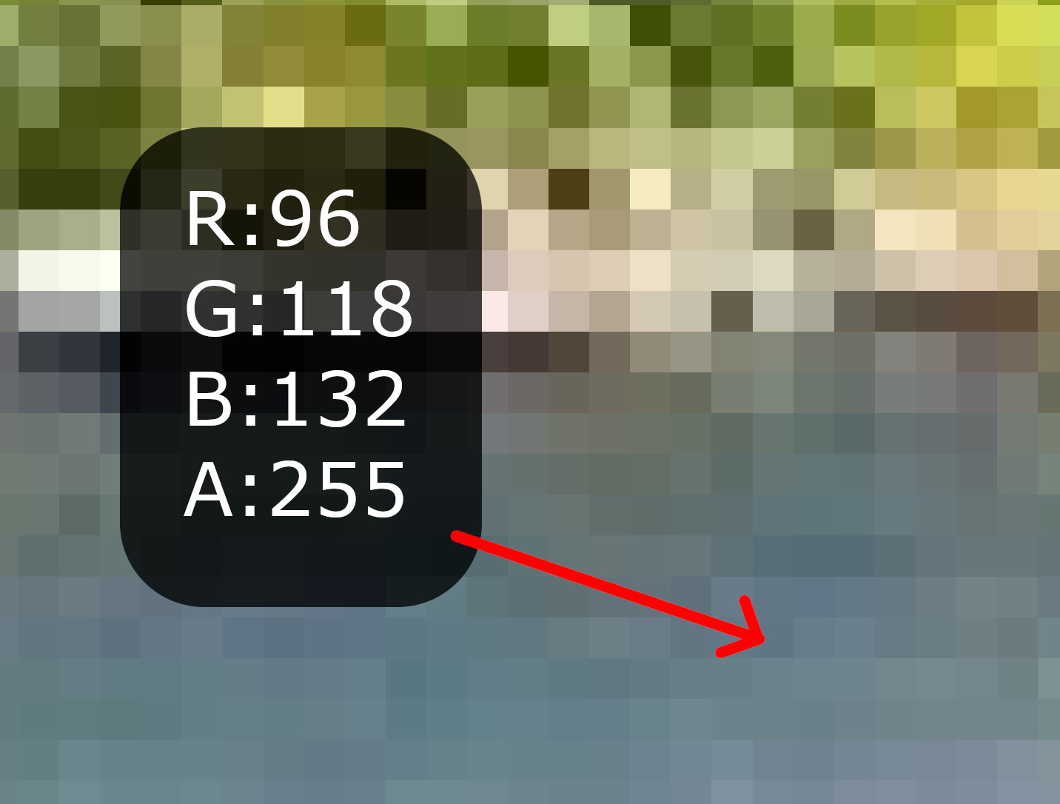
Anatomy of a Pixel
Each pixel holds four values, represented by an integer between 0 to 255.

Slide 4
Anatomy of a Pixel
Pixels were designed to be encoded in memory in sets of 4 bytes per pixel.
  A byte represents a space in memory consisting of 8 bits.
Behind the scenes, every pixel of any image you see on a screen is represented by a byte array alternating between a Red value, Green value, Blue value, and Alpha value.
If you google a wallpaper for your 1080p computer monitor, that image will contain:
  2,073,600 pixels OR
  8,294,400 bytes

Slide 5
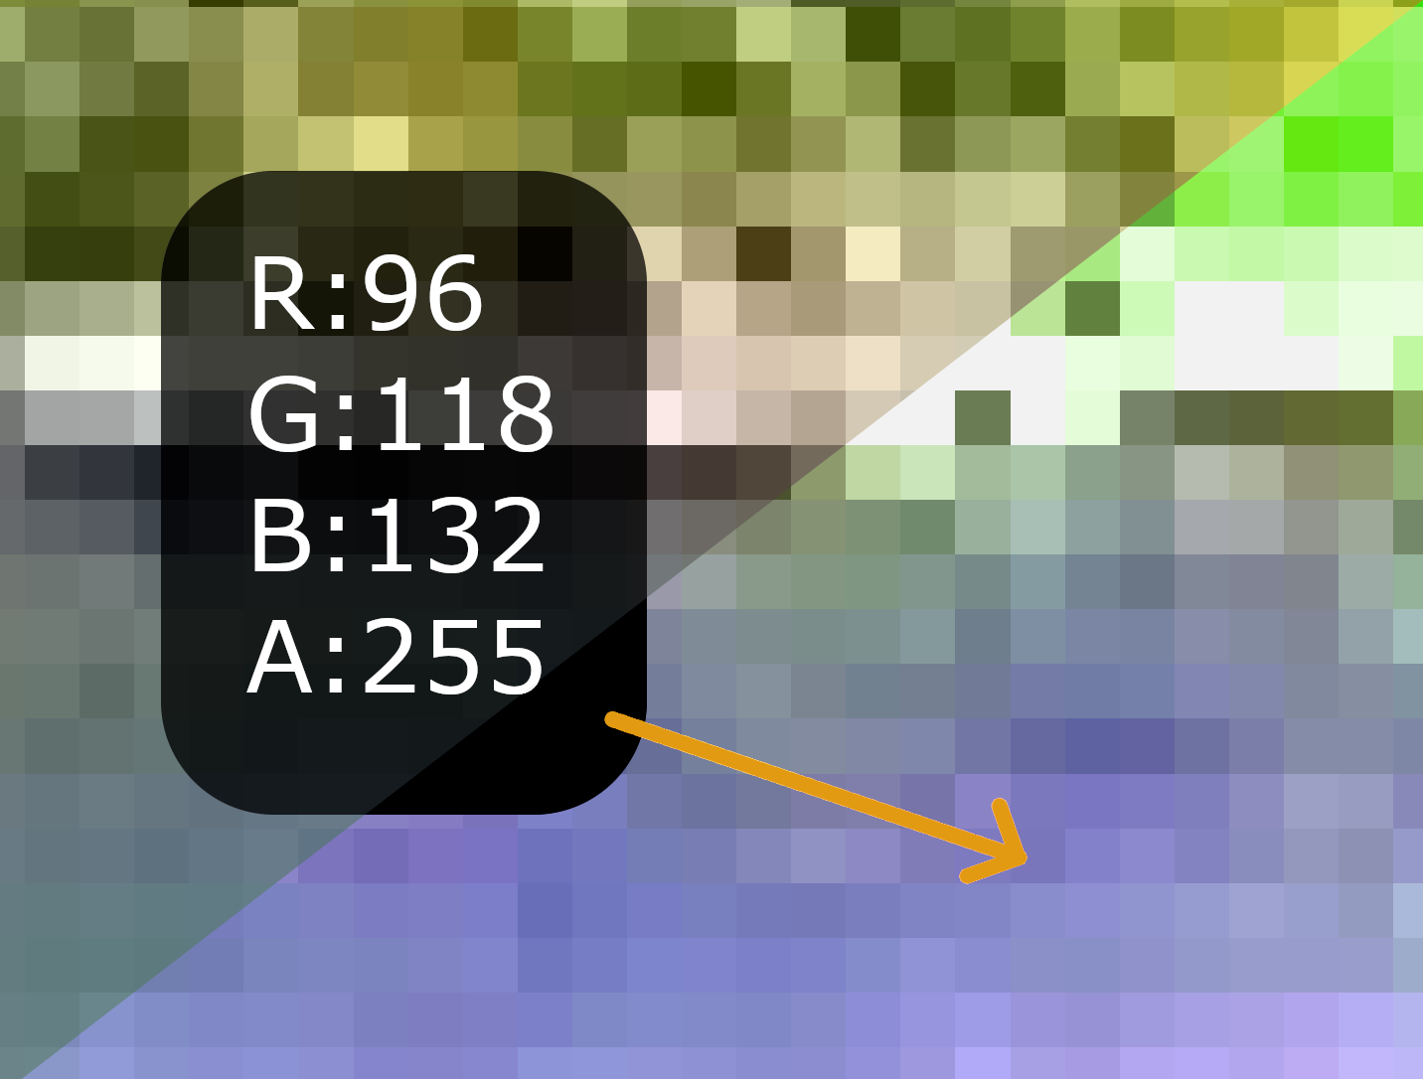
Image Processing
In order to manipulate an image, every single one of those 8 million+ bytes must be locked in memory, iterated over, and then modified individually.

Slide 6
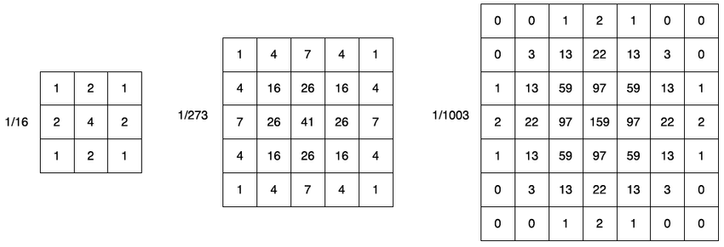
Blur using Kernel of Gaussian Distribution

Slide 7
Gaussian Blur
Kernel will iterate over entire image, byte by byte, calculating weighted averages.

Slide 8


Slide 9
Our Image Processor
Leila and I set out to create a simple image processor with broad, but limited, functionality.
Specifically , we set out to achieve the following functionality:
  Blur an image
  Apply a pixelate or mosaic-like effect on an image
  Explore manipulating bitmaps and the pixels that encompass them
  Create an application that was easily extensible and maintainable using design patterns.
  Follow SOLID principles for OO design.

Slide 10
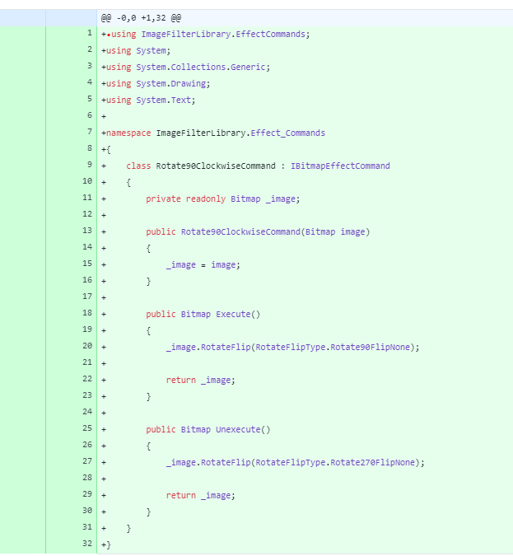
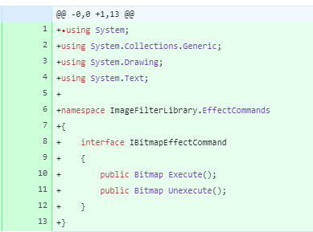
Application Architecture
Design Patterns and SOLID
Notes:
Encapsulates the action of the command for ease of use, extensibility, and undo.

Slide 11
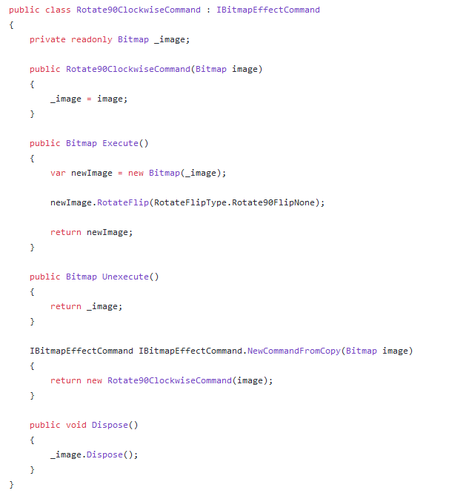
Command Pattern
Encapsulate the image manipulation logic inside of an object and use an Interface to guarantee functionality and allow for polymorphism at runtime.

Slide 12
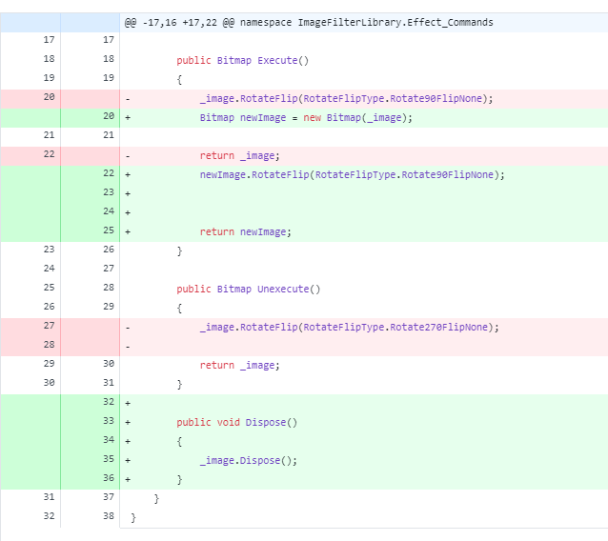
Implementing IDisposable
Images take up memory when they are being used, and even after all references to them are gone.
To avoid memory leaks, we needed manually dispose of any unused Bitmaps.
Notes:
The architecture is set up, it’s time to start creating our own algorithms.

Slide 13
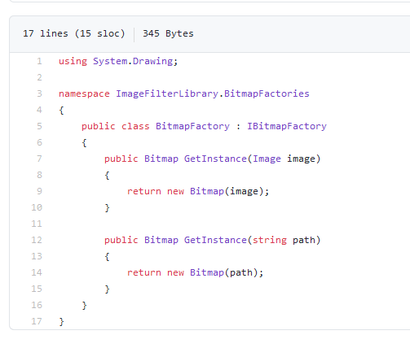
Factory Pattern
In order to decouple our library/models from our UI/View, we used a Factory Pattern implementation to create our objects for us.

Slide 14
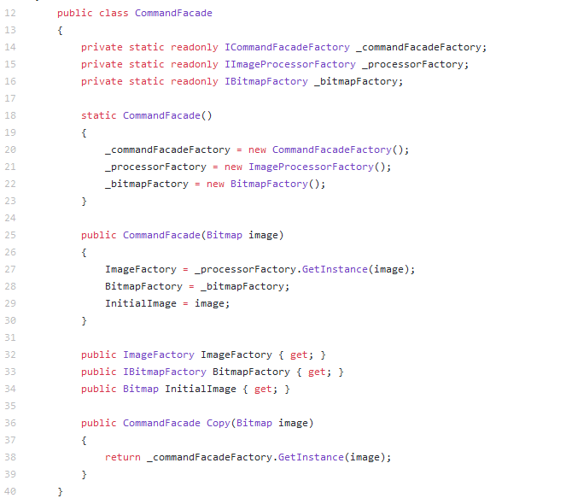
Façade Pattern
Our Commands were getting unwieldy and difficult to inject with parameters, so we used the Façade pattern to make the client interfacing easier.

Slide 15
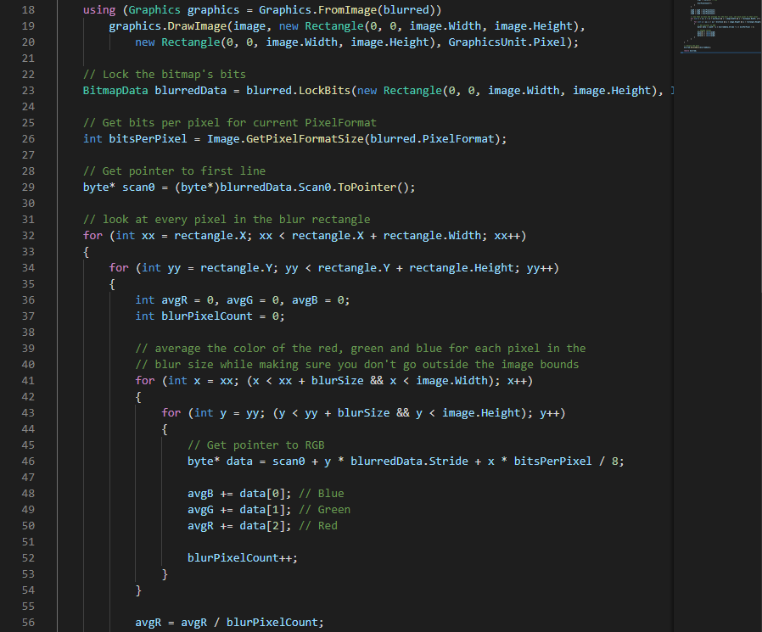
Lets explore LockBits!
LockBits is the C# method of locking all 8 million bytes in memory, and then using Pointer Arithmetic to iterate over them and manipulate the image.

Slide 16
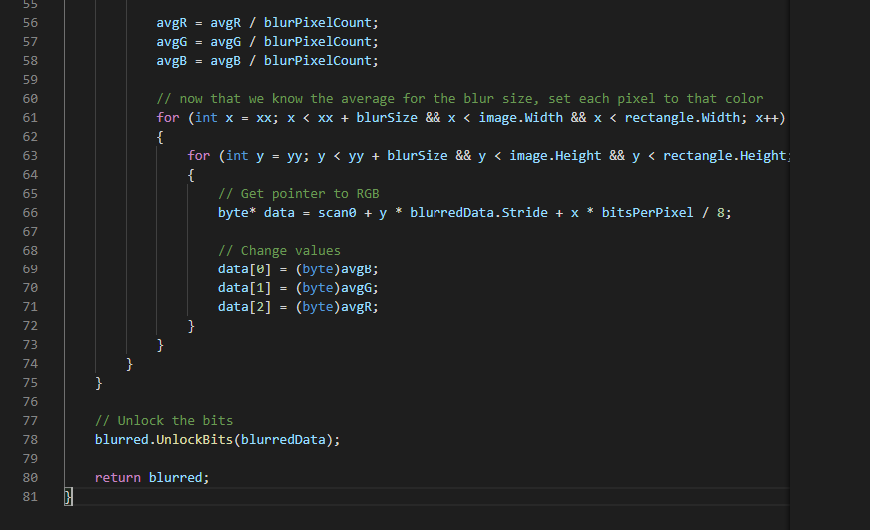
Exploring LockBits pt II
It’s just as straightforward and simple as it looks.

Slide 17

A New Solution
Notes:
Pointer arithmetic was neither something I nor Leila cared to explore. It had a high barrier to entry just to understand, let alone crafting our own algorithms in.

Slide 18
ImageProcessor Nuget Package
Neither Leila nor I wanted to try to tackle the steep learning curve that was pointer arithmetic.
  Even if one of us could become fluent with it, it seemed almost impossible to teach the other person, let alone craft a reasonably efficient/impressive photo processing algorithm.
ImageProcessor is a free Nuget Package that is simple to use and has broad use cases for manipulating images.
We made the decision to implement the ImageProcessor in our application rather than reinvent the wheel by manually creating all the processing algorithms.

Slide 19
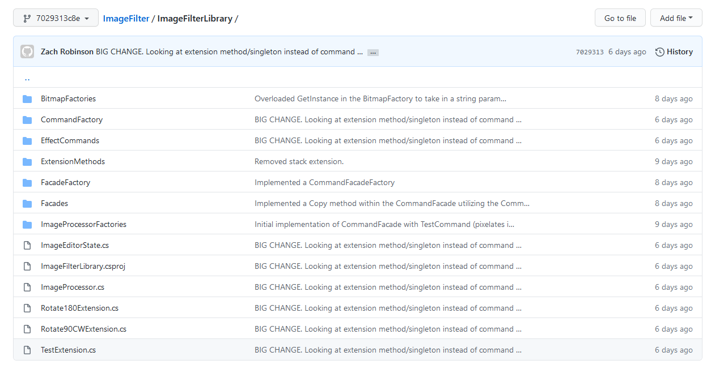
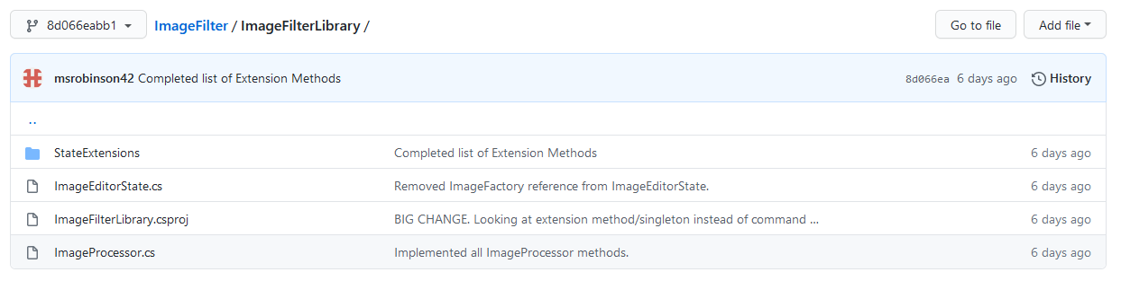
Extension Methods
Command Pattern Library
State Machine Library
Notes:
My beautiful architecture was undone by getting some advice from some other developers.

Slide 20
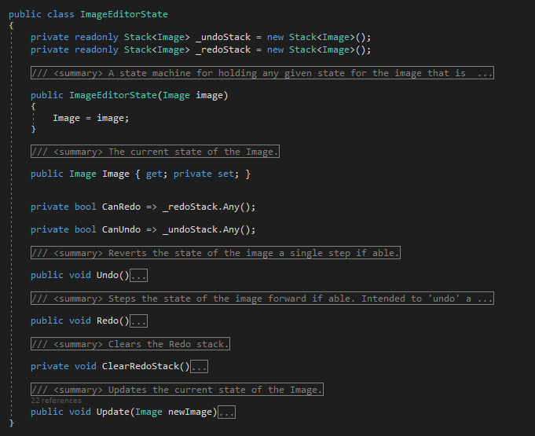
Image State Machine
All changes are held in this class as a mutable Image property with public get, but private set.
Any time a View wishes to update their own version of the image, it asks the library. No business logic in the WinForm.

Slide 21
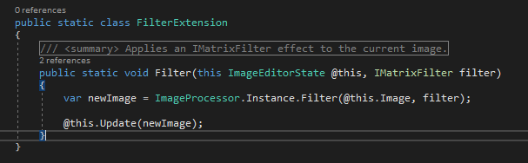
Extension Methods
All future functionality can be easily added by extending the ImageEditorState class by using this Extension Method syntax. Additional classes are small and readable.

Slide 22
Singleton
We use a Singleton class, which is a unique design where the class has a private constructor, and a readonly property so that other classes can use a single global instance of a certain object.
  No other objects of this type will ever be created anywhere else in the application.
This is the class used to interface with the ImageProcessor library and call the correct methods.
The code on the previous page was an example of calling this singleton class.
  e.g. ImageProcessor.Instance.Filter(@this, filter);

Slide 23
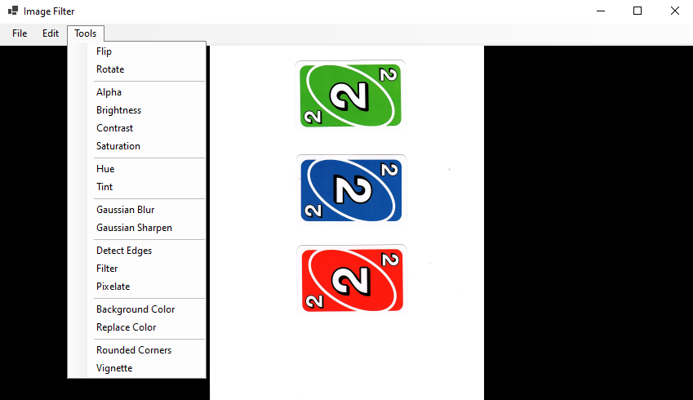
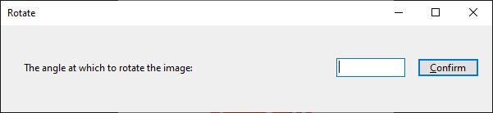
Creating the UI
Finally, we created the UI elements starting with the Main Form.
We also designed multiple InputDialogs that are modular and created at runtime!
All dialog forms have input validation for their respective fields.

Slide 24
Let’s Explore our Image Processor

